Slide 1
Canteen Management System Using HTML & CSS Team -1

Slide 2

Canteen Management System Using HTML & CSS
Web-based solution for easy access
Streamlined food ordering process
Reduced queues during peak hours
Enhanced campus dining experience

Slide 3
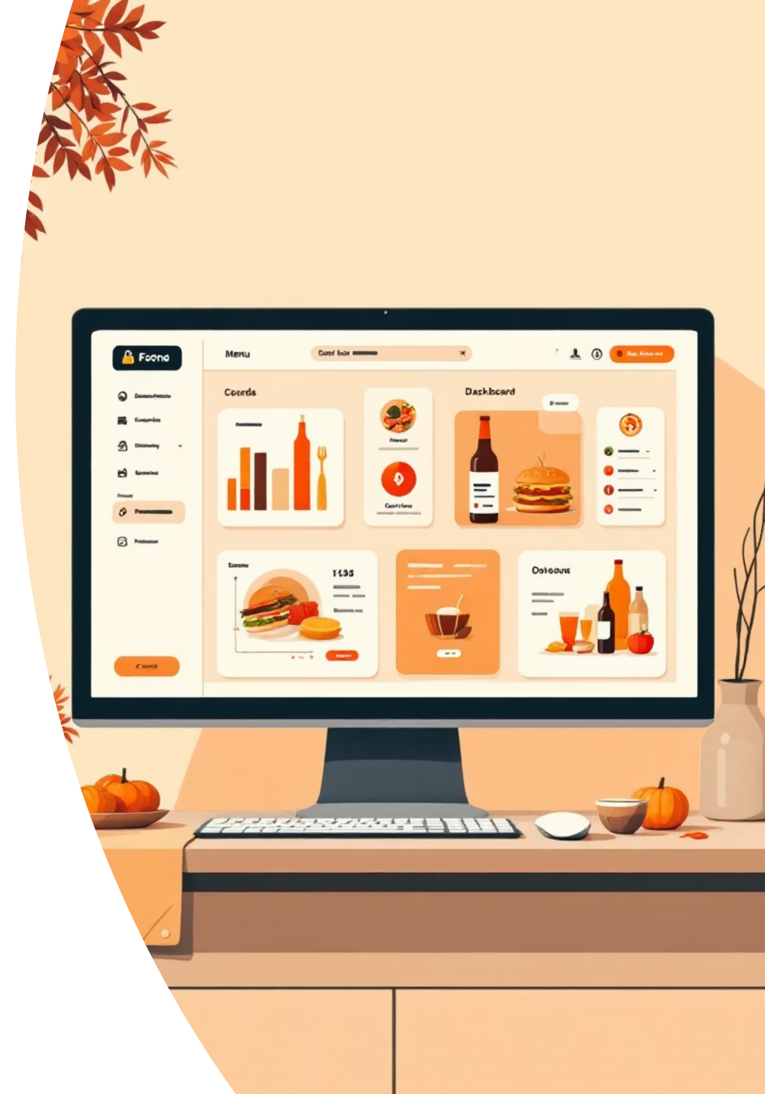
What is a Canteen Management System?
Web-Based Platform
Streamlined Ordering
Built with HTML and CSS for an accessible online ordering interface for campus food services.
Students and staff can easily browse menus, select items, and place orders digitally.
Integrated Billing
Features automatic payment processing and order tracking for transparency and reduced errors.

Slide 4
The Problem We're Solving
Current Challenges
The Solution
Long queues cause frustration and wasted time during peak hours.
A digital system that automates ordering, billing, and inventory management—saving time and reducing errors.
Manual billing errors lead to payment discrepancies and disputes.
Inventory tracking is scattered and inefficient.
Order records are difficult to retrieve and analyze.

Slide 5




HTML & CSS: Building the Foundation
HTML Structure
Organizes menus, forms, buttons, and navigation elements.
Provides logical and semantic markup for content.
CSS Styling
Applies colors, layouts, and fonts for visual design.
Ensures responsive design for various screen sizes.
Creates an engaging visual experience.
User Experience
Delivers a clean and intuitive interface.
Ensures seamless functionality across all devices.

Slide 6
Key Features & Capabilities
1
Secure Login System
Student and staff authentication to ensure personalized, secure access to orders and accounts.
2
Categorized Menu Display
Organized food items by breakfast, lunch, and snacks with descriptions, prices, and images.
3
Interactive Ordering Interface
Intuitive forms and buttons for selecting items, quantities, and special instructions.
4
Responsive Design
Media queries ensure optimal viewing on mobile phones, tablets, and desktop computers.
5
User Feedback & Engagement
Hover effects and button state changes provide visual cues that
enhance interactivity and user confidence.

Slide 7

System Workflow
Browse Menu
User visits the website and explores categorized food items with pricing and details.
Select & Order
User adds items to cart, specifies quantities, and submits the order form with delivery preferences.
Process Payment
Automated billing calculates totals and processes payment securely through integrated payment gateway.
Confirmation & Preparation
Order confirmation is sent to canteen staff; they prepare the meal while user receives real-time updates.

